Slide 1
Retail Sales Performance and Profitability Investigation
SAHEED oLAYINKA Adebiyi
Data analyst

Slide 2
Problem Statement
This comprehensive analysis addresses some critical business questions raised by leadership regarding retail sales performance, profitability, customer behavior, and operational efficiency which are listed below
There is limited visibility into true product profitability, making it difficult to identify which items genuinely drive profit versus volume.
Despite stable sales volume, the business is experiencing fluctuating revenue and inconsistent profit margins across multiple product categories.
Customer behavior patterns and lifetime value are unclear, preventing effective identification of the most valuable customer segments.
The organization lacks insight into seasonal and time-based sales trends, reducing its ability to optimize inventory and promotions.
These gaps hinder data-driven decision-making, impacting pricing strategies, customer retention, and overall business performance.

Slide 3
Objectives
To investigate fluctuations in revenue, customer behavior, and product profitability while identifying opportunities for improved margins, customer retention, and operational efficiency.
Identify whether our revenue growth is translating into real profit or being eroded by high costs
Analyze the categories with high sales volume that also deliver strong profitability
Study which customers drive the most revenue and repeat purchases.
Examine and tailor promotions and product offerings to the right demographic groups.
To determine the sales trend over time
To determine whether customers typically make bulk purchases or small, frequent ones

Slide 4
Overview of data
The data consist of 2,000 rows and 12 columns which is clean without duplicates and empty spaces except for creating new conditional columns
Dataset main columns include: transaction_id, customer_id, gender, age, category, quantity, price_per_unit, total_sale, cogs, total_cost, sale_date, sale_time

Slide 5
Implementation Outline
The tool I used for the entire analysis process is Structured Query language (SQL)

Slide 6
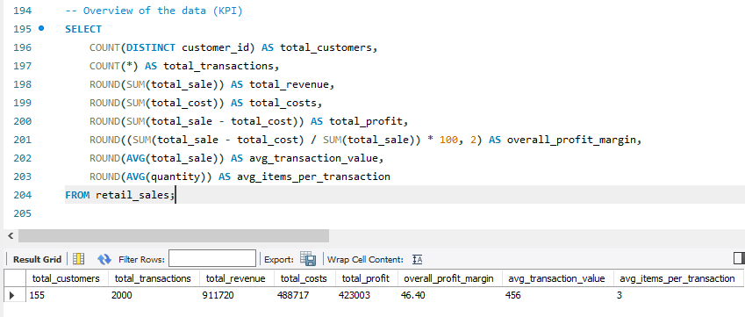
KPI

Slide 7
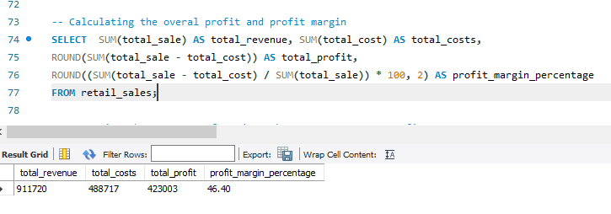
ANALYSIS

Slide 8
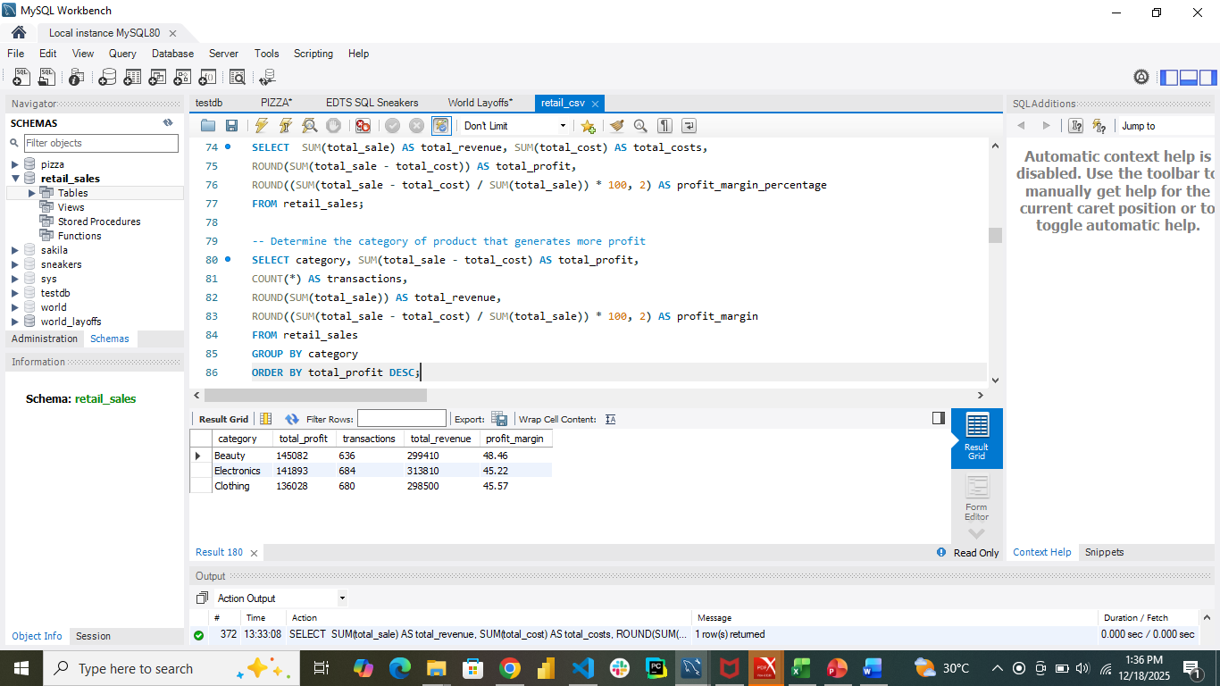
ANALYSIS

Slide 9
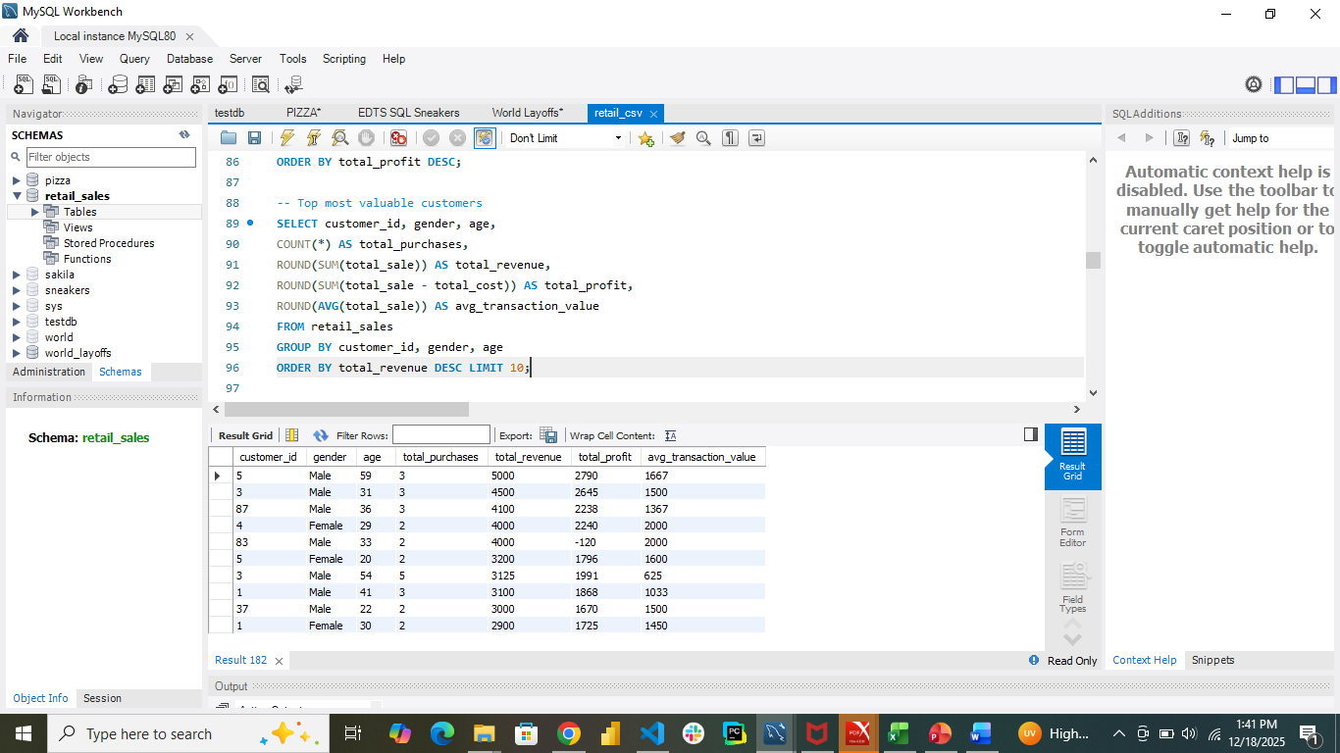
ANALYSIS

Slide 10
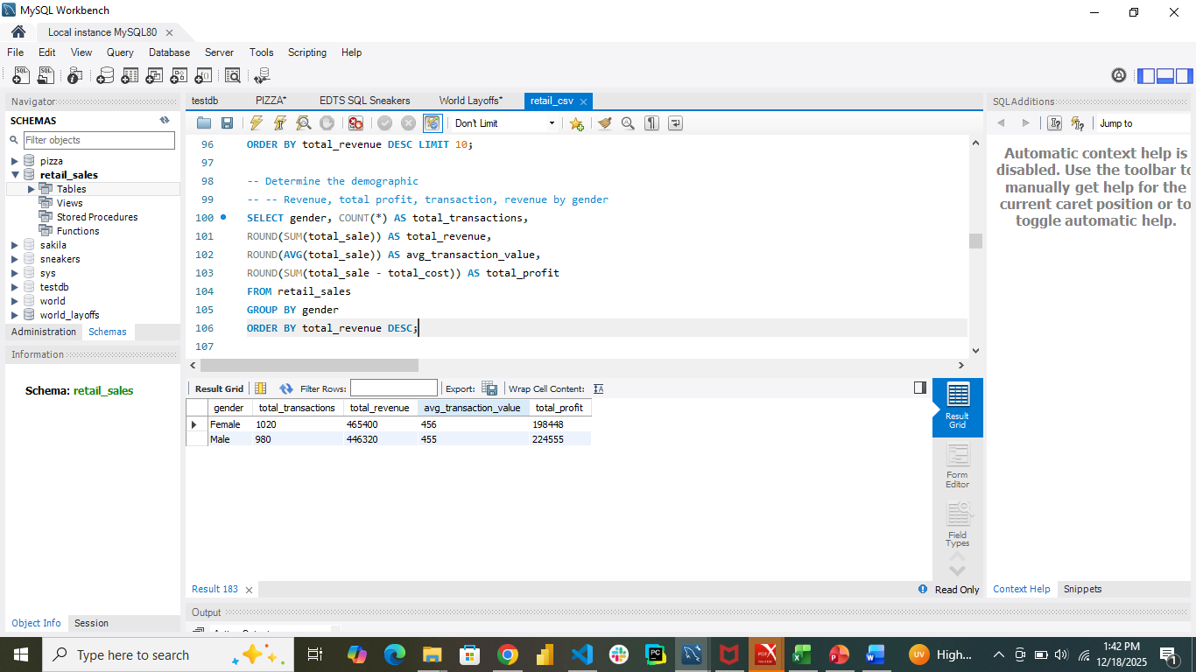
ANALYSIS

Slide 11
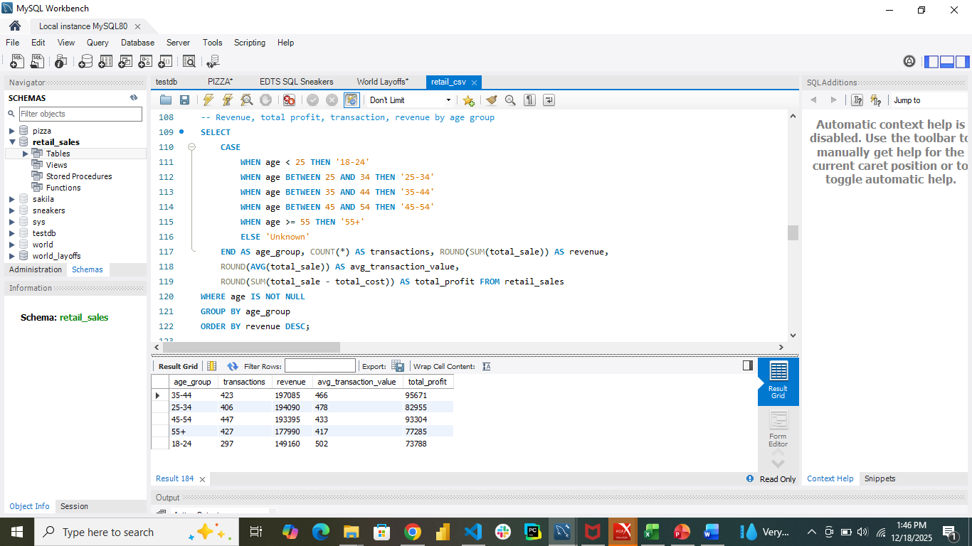
ANALYSIS

Slide 12
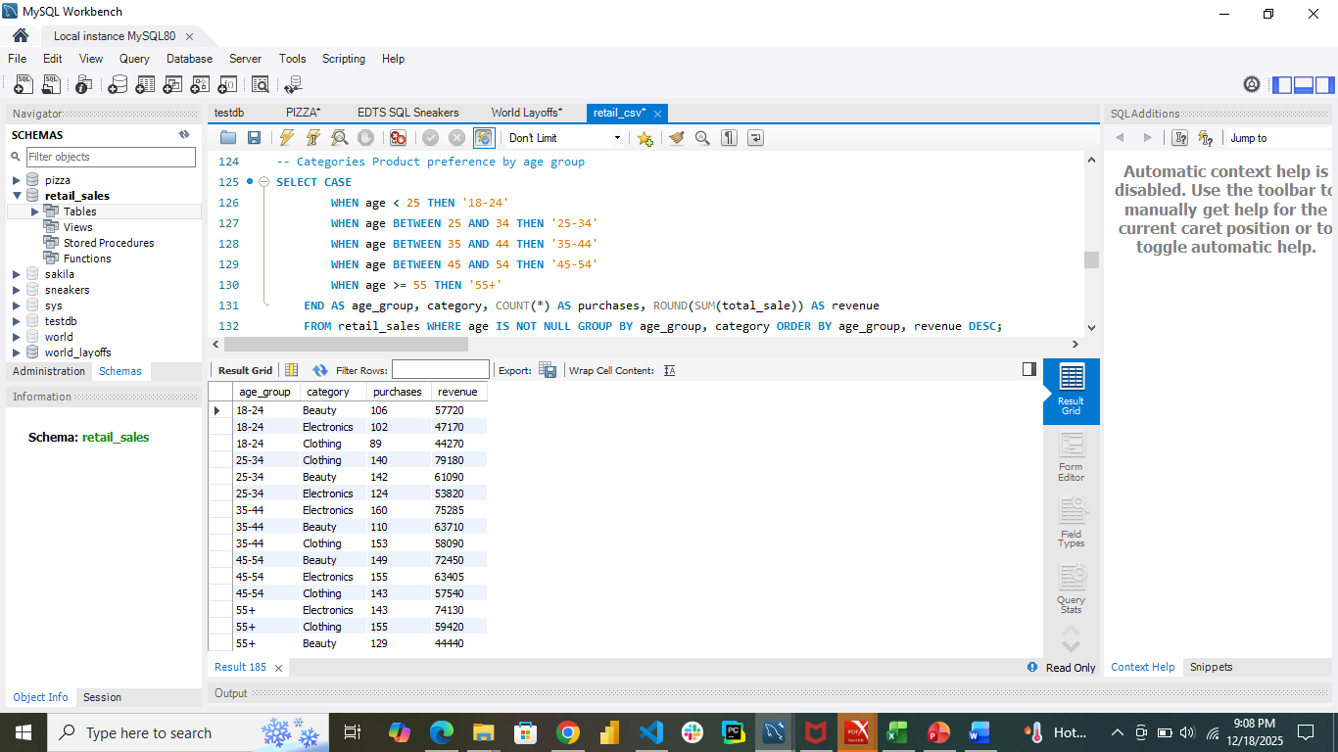
ANALYSIS

Slide 13
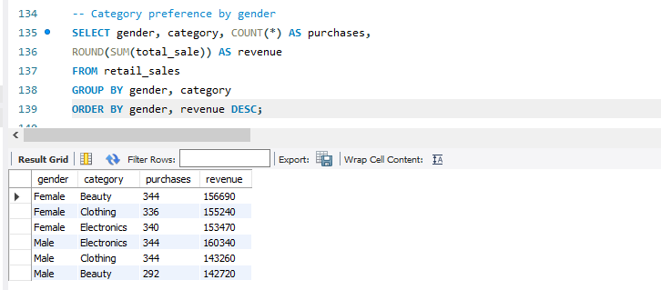
ANALYSIS

Slide 14
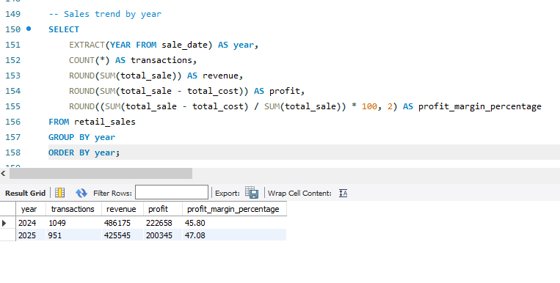
ANALYSIS

Slide 15
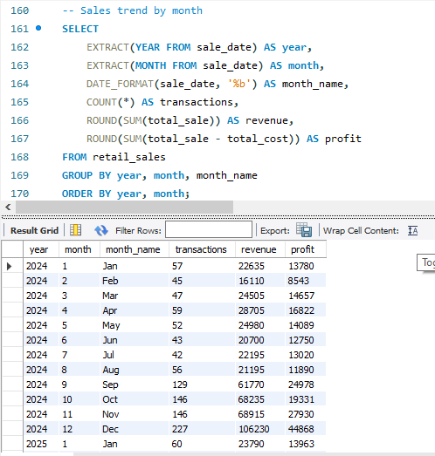
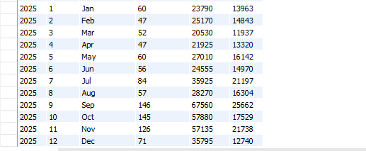
ANALYSIS

Slide 16
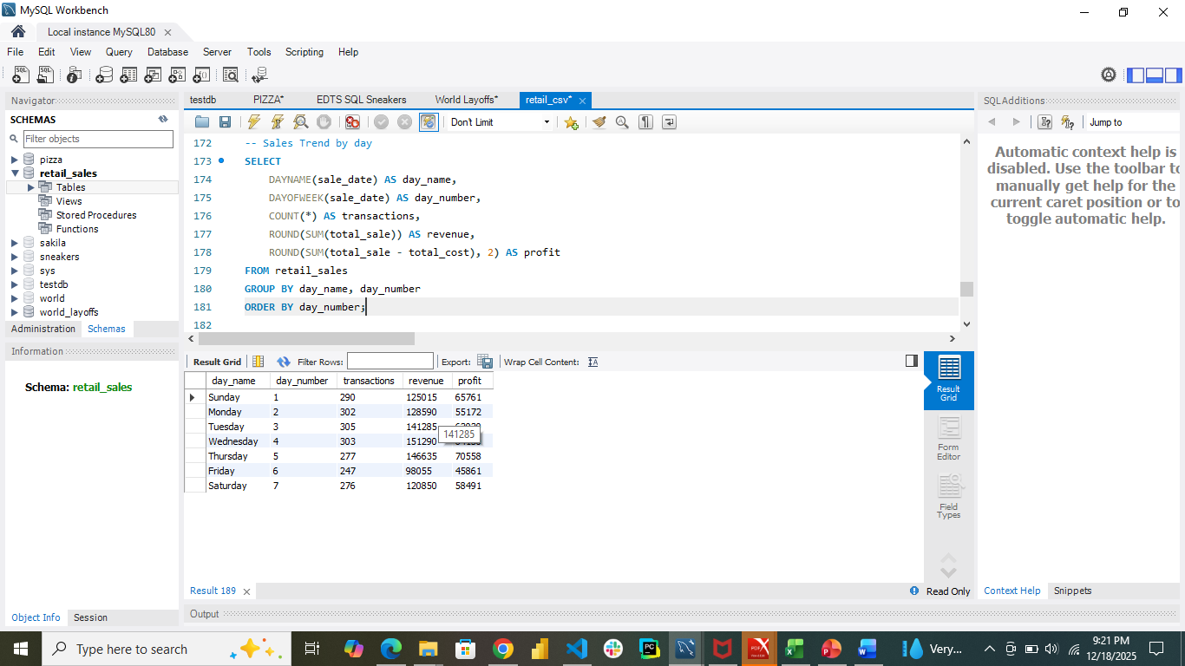
ANALYSIS

Slide 17
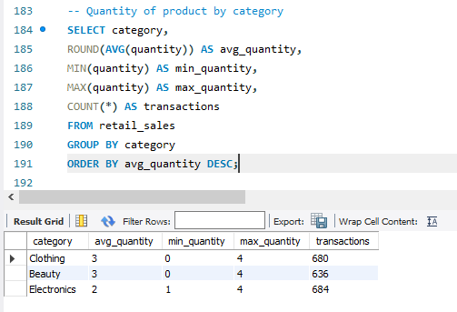
ANALYSIS

Slide 18
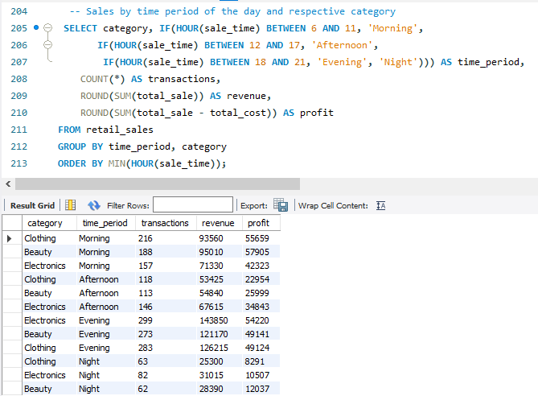
ANALYSIS

Slide 19
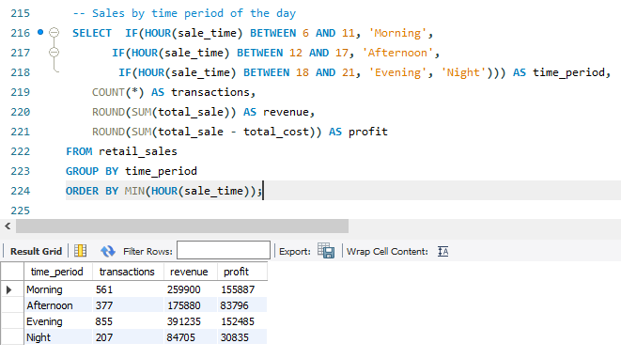
ANALYSIS

Slide 20
Key Finding of Performance Dashboard
Key Findings Summary
Established clear investment priorities based on profit margins and transaction volumes
Segmented customers by lifetime value and identified top revenue generators for retention programs
Revealed distinct purchasing patterns across age groups and genders for targeted marketing
Identified peak sales periods for optimized staffing and inventory management
Analyzed quantity patterns to inform inventory planning and promotional strategies

Slide 21
CONCLUSION
This comprehensive analysis has provided critical insights into six key business questions regarding retail sales performance, profitability, customer behavior, and operational efficiency.

Slide 22
Recommendation
Increase marketing spend on high-margin, high-volume categories
Develop win-back campaigns for one-time purchasers
Implement personalized recommendations based on purchase history
Adjust staffing levels to match peak sales periods (by day and hour)
Optimize inventory stocking based on seasonal and monthly trends
Schedule promotions during slower periods to balance revenue throughout the year
Implement bulk discount strategies to increase average basket size

Slide 23


